Slide 1


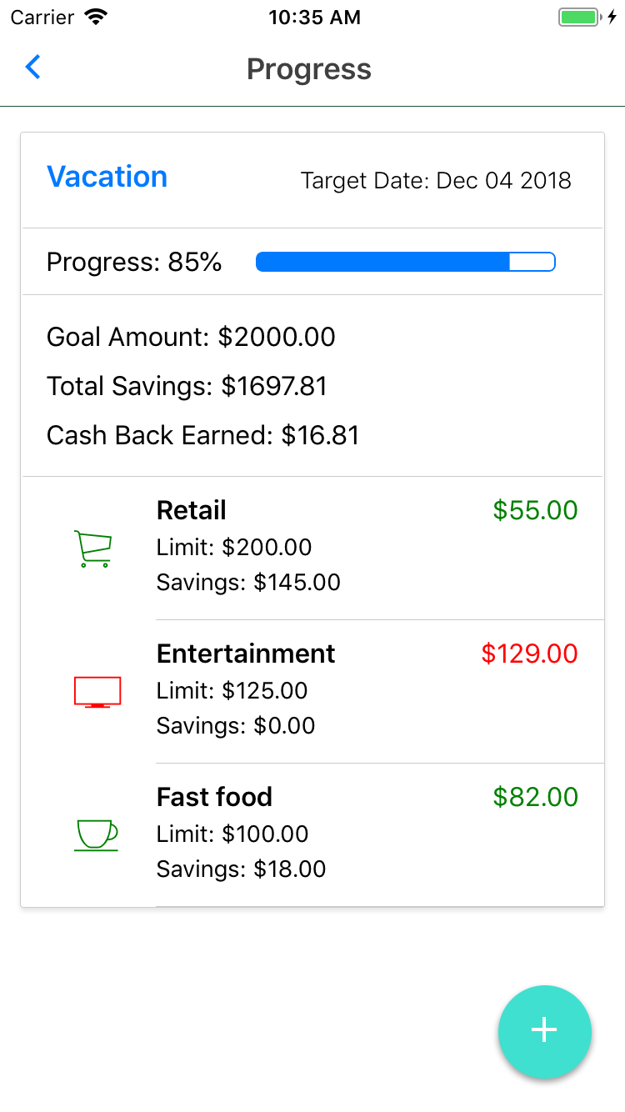
SmartSave
Helping you achieve your savings goals

Slide 2

Overview
TD Level Up Quest
The Challenge
What We Built
Overall Experience
Next Steps

Slide 3
TD Level Up Quest
Month-long hackathon to design and develop an app that supports The Ready Commitment
Equal focus on business potential and value as well as technical development using APIs
Community Banking Platform: virtual bank with millions of simulated customers, accounts, transactions

Slide 4




The Ready Commitment
Early Learning
Affordable Housing
1
3
2
Income Stability
4
Financial Literacy

Slide 5

The Challenge

Slide 6
Produce an app that uses the Community Banking Platform to help your generation, or those coming up after you, to achieve financial security.

Slide 7


The Market

Slide 8
2018 Bank of America Report
73% of millennials say their generation overspends on unnecessary indulgences.

Slide 9
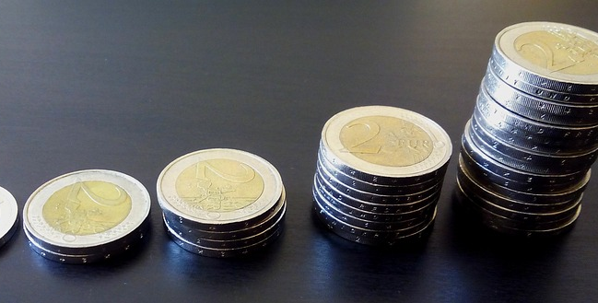


SmartSave
How We Should Save
What We Should Save
Why We Should Save
Smart Notifications to Promote Savings
Categorized and Contextualized Data
Cash-Back Incentive to Build Good Habits

Slide 10
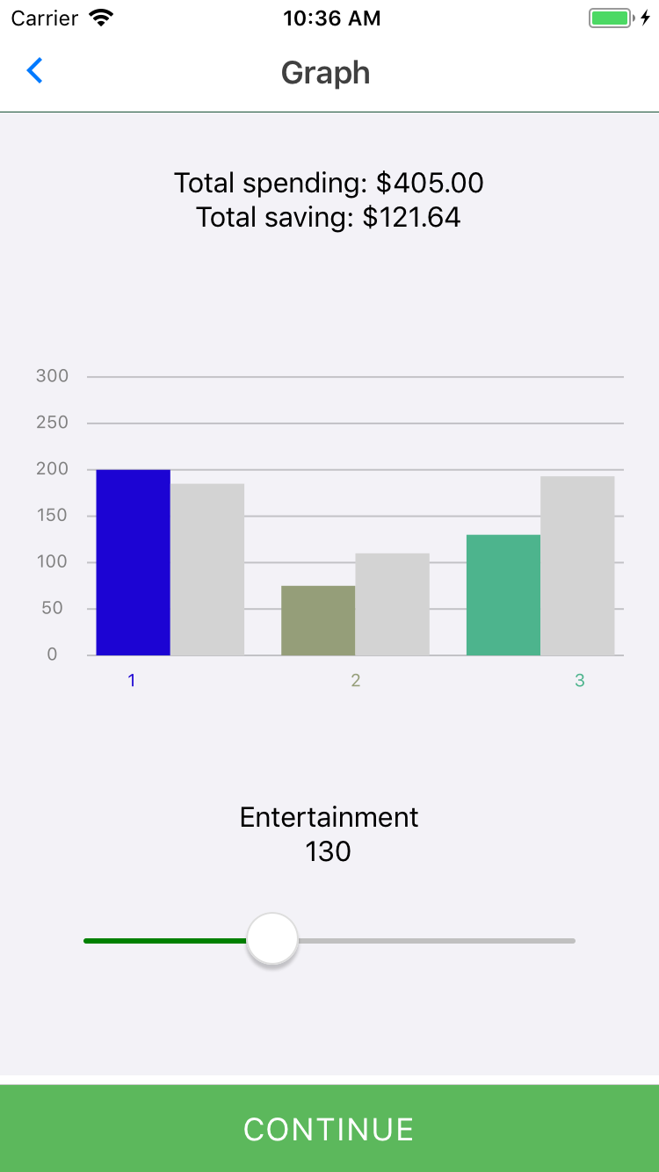
What We Should Save
Contextualized and Categorized Data
Problem: How do we know if we are overspending or performing well in certain categories compared to others?
Solution: Use information from the CBP to filter and aggregate data to compare our personal spending habits relative to our peers.

Slide 11
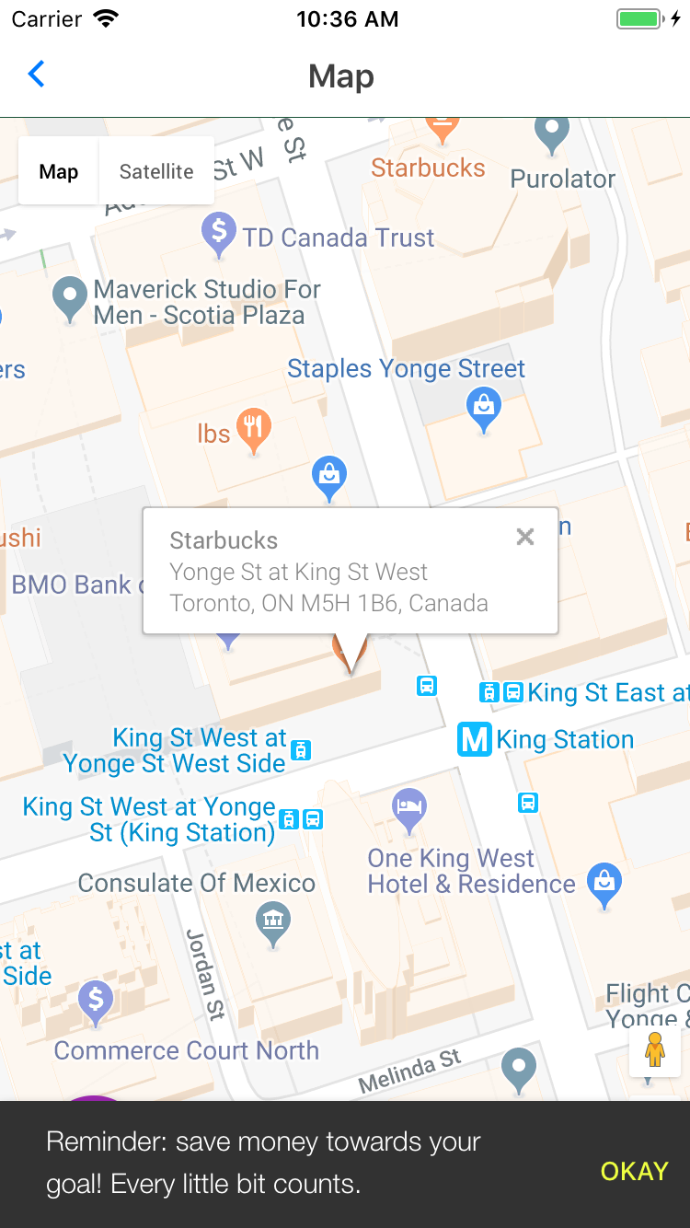
How We Should Save
Smart Notifications to Promote Savings
Problem: How can we get smart reminders to help us save by alerting us before we make an impulsive purchase?
Solution: Use Google Maps to get our location and IBM Watson’s machine learning APIs to assess how likely we are to make a purchase.

Slide 12
Why We Should Save
Cash-Back Incentive to Build Good Habits
Problem: How can we help our customers increase financial security and build good saving habits from an early stage?
Solution: Provide a strategically-designed cash-back incentive on savings through the app to help develop good habits.

Slide 13
Business Value
New Customer Acquisition
Build Customer Loyalty
Increased Portfolio Size
Our helpful services and cash-back savings incentive will help TD acquire new customers
By providing useful services to help customers build financial security, we increase loyalty and trust
More savings in TD accounts means greater potential for returns on investments

Slide 14
Technologies
React Native
Community Banking Platform
Google Maps API
IBM Watson Personality Insights
Twitter API
Flybits (future implementation)

Slide 15

Next Steps
Build a working demo with core functionality
Showcase the final app at Waterloo’s Hack the North
August
Future
July
September
Make the app more robust and integrate additional APIs
To be continued…

Slide 16
Thank you.

